Slide 1
Guide to Finance and Investing in the Market
Notes:
Anybody know something about the stock market?
What is a stock?
What is something that always puzzled you? (or something you wish me to explain?)

Slide 2
Outline (DOWNLOAD PDF AND PUT IN CHAT)
Basics of Investing
How Stock Market works?
How to Invest?
Why Invest?
Technique to Analyzing Companies
Technical Investing
Fundamental Investing
Investing Philosophy
Under/Over Valued Investing
ESG
Religious

Slide 3
How to Invest
A deep dive of major players in the Market
Putting it all Together: How to survive/thrive in a pandemic
Notes:
Class 1 - 5Ws of Investing
vaccine race
the election’s impact
ETFs,
IPOs,
Mergers and Acquisitions,
Stock Split
Trade Wars

Slide 4
0) What is the Stock Market?

Slide 5
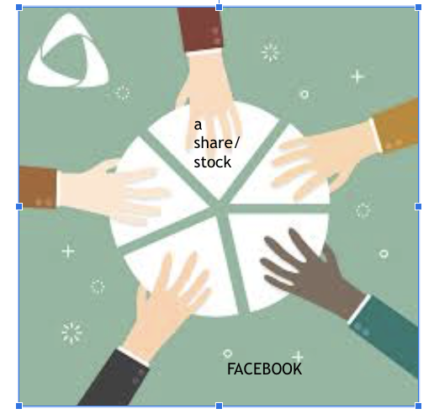
What is a stock?
piece of a pie
become a shareholder
Notes:
can anyone give me two ways to make money? now that you’re a shareholder
Imagine that Facebook is this pie. Then imagine taking a piece of this pie. You can think of this piece as your stock. So there are five shares in total and now you have one. Now, you can Wait until your piece becomes valuable and then sell, or wait for Facebook to pay you a dividend, which is basically a small amount of money , a dollar , as a thank you for simply being an “owner” in the company. The market is just where one buys and sells these “pieces” of the pie.
what is a stock?
an ownership of a company
What is the SM?
A place where people go to buy and trade these stock
What are the two ways to make money?
by investing in stock with money you could have invested elsewhere , you are rewarded with some money, other known as dividend (20 cents i.e).
You can sell the stock at a higher price.
*whenever you buy or sell, companies not affected

Slide 6
The (secondary) stock market
Sell it for higher!
capital gain
2) Dividend
passive money gained from owning stock
Notes:
can anyone give me two ways to make money? now that you’re a shareholder
Imagine that Facebook is this pie. Then imagine taking a piece of this pie. You can think of this piece as your stock. So there are five shares in total and now you have one. Now, you can Wait until your piece becomes valuable and then sell, or wait for Facebook to pay you a dividend, which is basically a small amount of money , a dollar , as a thank you for simply being an “owner” in the company. The market is just where one buys and sells these “pieces” of the pie.
what is a stock?
an ownership of a company
What is the SM?
A place where people go to buy and trade these stock
What are the two ways to make money?
by investing in stock with money you could have invested elsewhere , you are rewarded with some money, other known as dividend (20 cents i.e).
You can sell the stock at a higher price.
*whenever you buy or sell, companies not affected

Slide 7
Cont.
3) MINOR NOTE: Exercise your rights as an owner
vote
Notes:
can anyone give me two ways to make money? now that you’re a shareholder
Imagine that Facebook is this pie. Then imagine taking a piece of this pie. You can think of this piece as your stock. So there are five shares in total and now you have one. Now, you can Wait until your piece becomes valuable and then sell, or wait for Facebook to pay you a dividend, which is basically a small amount of money , a dollar , as a thank you for simply being an “owner” in the company. The market is just where one buys and sells these “pieces” of the pie.
what is a stock?
an ownership of a company
What is the SM?
A place where people go to buy and trade these stock
What are the two ways to make money?
by investing in stock with money you could have invested elsewhere , you are rewarded with some money, other known as dividend (20 cents i.e).
You can sell the stock at a higher price.
*whenever you buy or sell, companies not affected

Slide 8
Part 1: How Companies Get on the Stock Market

Slide 9
How does it work?
Company start as privately owned
To make more money, It raises an IPO.
investors own your company
company is now public
Notes:
DOES NOT APPLY to NONPROFIT COMPANY - the goal of nonprofit is to boost mission, not make money
-> HSSP: ipo
-> first time company becomes available on the market
-> people buy shares of a company
can anyone give me two ways to make money? now that you’re a shareholder

Slide 10
How does it work: from company side
Money from ipo funds various operations of including:
goods production
renting offices
hiring employees
Notes:
What happens to your money after you invest?
shares are then traded among investors (doesn’t affect company)
Why do ppl invest in the stock market?

Slide 11
Part 2) How to participate in market?

Slide 12
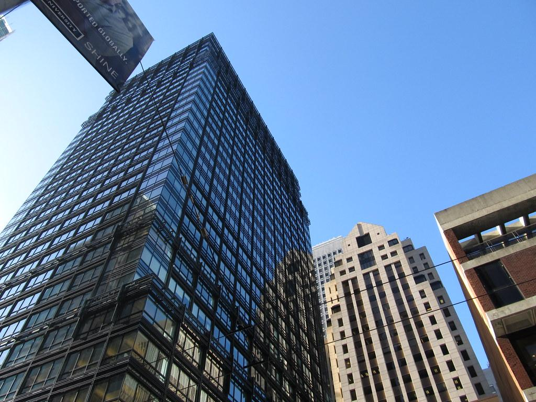
How do you participate in the stock market?
Independent method
via a Financial Broker (in jpmorgan, gs, etc.)
– who buys/sells stocks for you
Can do online trade also
e-trade, robinhood, etc.
Notes:
money manager - think hedge fund like berkshire; they make money for you and put it into your acct
*all of this, by the way, is via the secondary market.
online trading more risky - rules put in place to prevent over trading; popular recently (1min)

Slide 13
cont.
3) With help - Money manager
someone who manages and invest your money for you
less work on your end, but more obscure process
require minimum deposit
work in a mutual fund
examples: vanguard, s&p, etc. Invesco
Notes:
easier to just dump work on other ppl, but you don’t really know everything their doing!

Slide 14
Part 3) How to buy/sell on market?

Slide 15
What can I buy?
~ invest in stock market
Buy or sell in stocks
- a little risky/ but higher ret
in an ETF
low risk, lower return annual
a fund that allows you to invest in one’s portfolio like a stock instead of giving your money
i.e. SP 500 -> tracks 500 “financially sound” companies
easy way to invest in apple, other companies at the time; very passive
Notes:
regular stocks riskier but better payoff

Slide 16
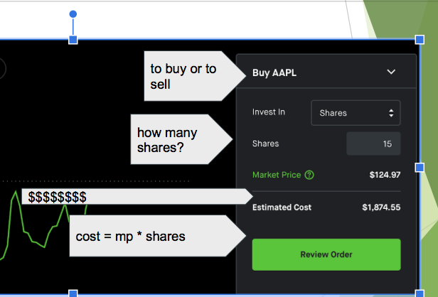
How the transaction works (ONLINE)
Notes:
depending on what where you go, this is what you might see
how much is 10 shares of apple? 1249.7
process is somewhat similar in person and for mutual funds

Slide 17
How to read a stock chart
At any point, you can: buy, sell (see day trade), or hold it and wait (until market close)
Notes:
selling it in the same day - day trading - very risky!!!!! price swings are high
selling it in a week(s) after a few weeks, much safer
sometimes ppl wait (buy low sell high)

Slide 18
4) why I should invest?

Slide 19
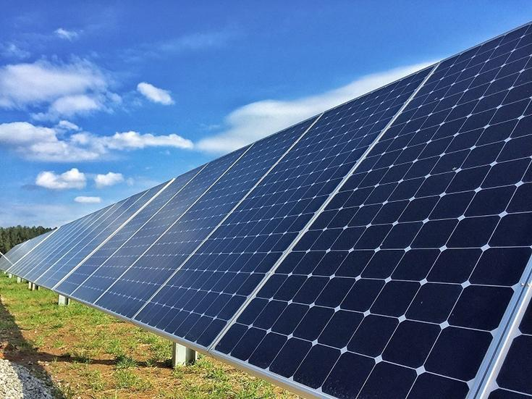
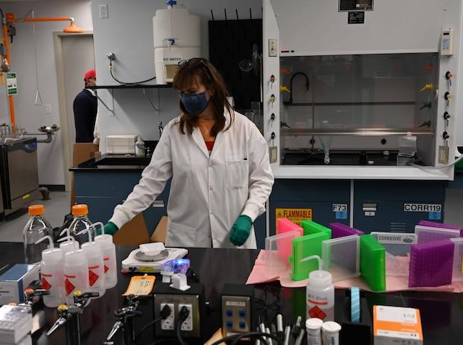
Why do people invest in the stock market?
Make an impact on companies;
to fund certain companies
to influence company decisions
Notes:
To support companies, who use investors’ (your) money to fund their operations (paying workers, redeveloping drugs, RD etc.)
i.e
1)clean energy stocks! - there’s increasing awareness of climate change impact; biden election is focusing partly on reversing that impact.
(Enphase Energy - Solar stock)
*AI companies!
2)Health care - prosthetic tools/drugs - vaccine!
*Beyond Meat - sells vegan meat; for those who want better climate and healthier lifestyle;
Impact company decisions -
you are allowed to board of directors
maybe one has an ethical stance, you might want to vote to keep in pwr
like BK and environment
Common vs preferred equity

Slide 20
Why do people invest in the stock market?
Personal reasons
a way to save extra money
a way to make profit
Notes:
A place to spend extra money;
like a bank acct; but maybe more productive? (earn passive income)
is it better or worse?
To make a significant amount profit.
which can be used to raise money.
which can be used for self or others
Common vs preferred equity
what’s one platform for trading (Either online or in real life)

Slide 21
SECTION 2: Two ways to Analyze Companies

Slide 22
Technical Analysis

Slide 23
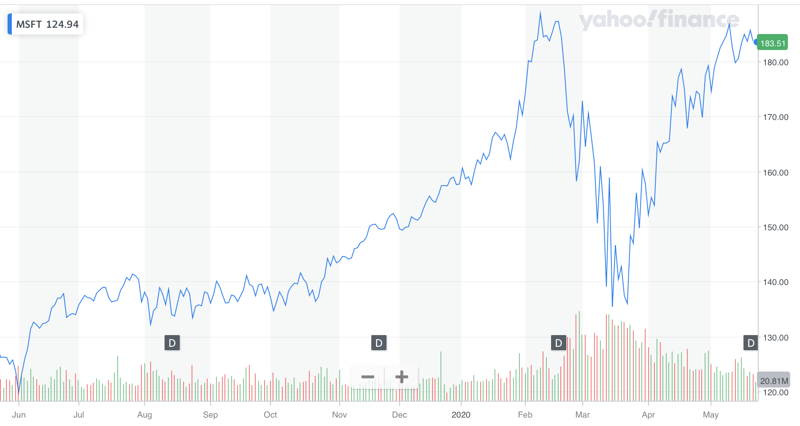
Activity: Guess the price?
Notes:
finding profitable companies
learn to look at trend,
patterns (not company) can dictate price
For this activity, I show you a stock chart like the above, cover up half of it, and have you decide whether or not the trend will move up or down based on the trend that you see.
trick: try to look for patterns!

Slide 24
Try to guess the direction (up, down, same) of price before moving on...

Slide 25
Notes:
i’d argue that it mostly stayed the same (if it went up it was by little);
you can probably argue the otherway

Slide 26
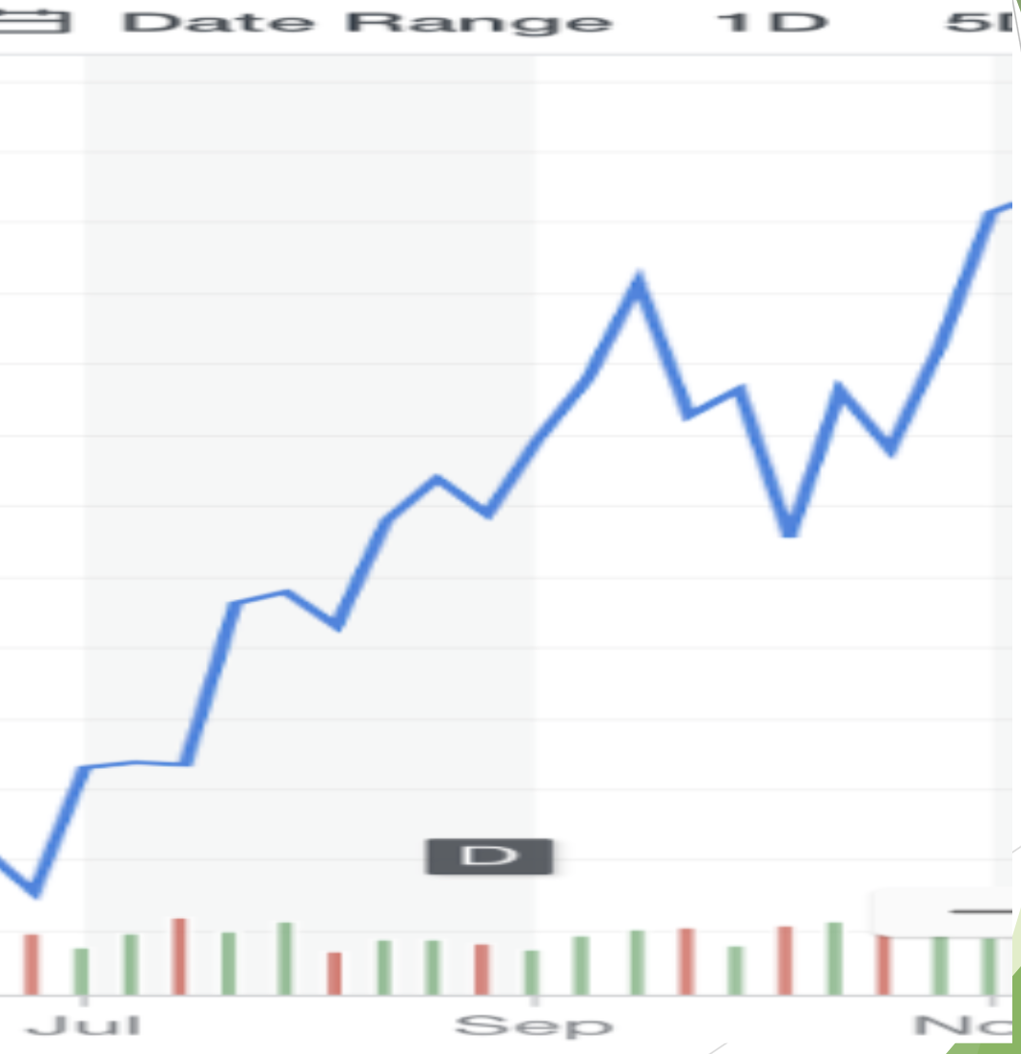
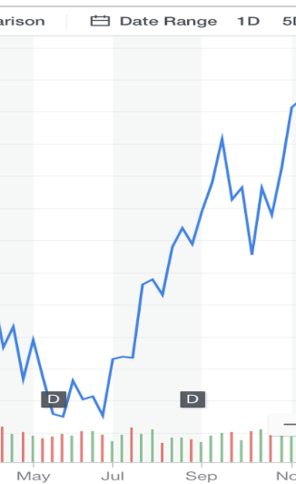

Slide 27
Notes:
The trend is increasing -> so it will continue to increase in the next slide

Slide 28
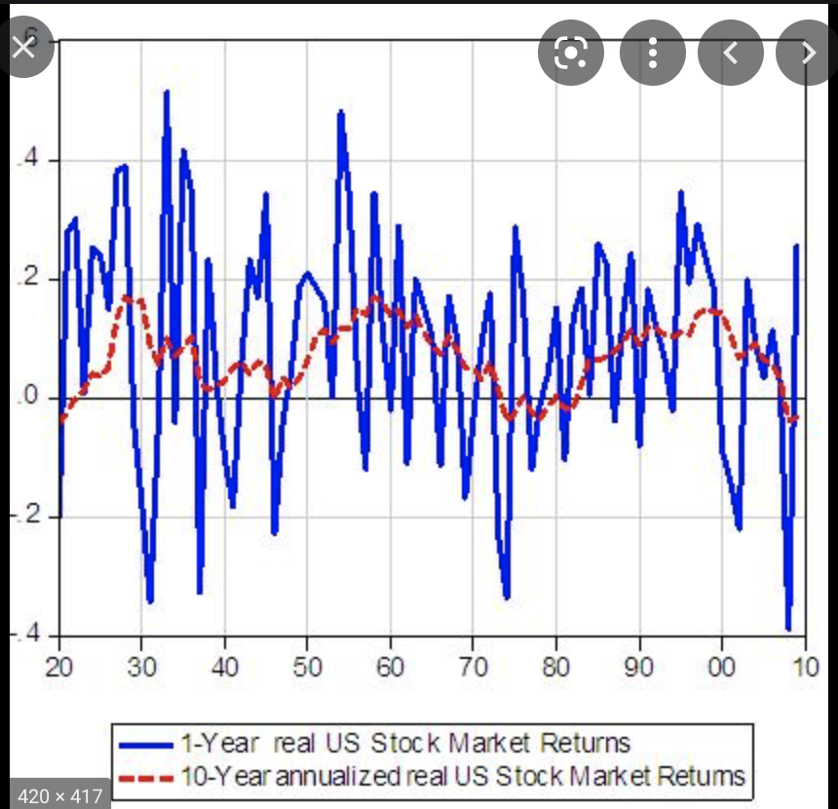
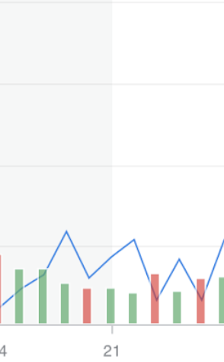
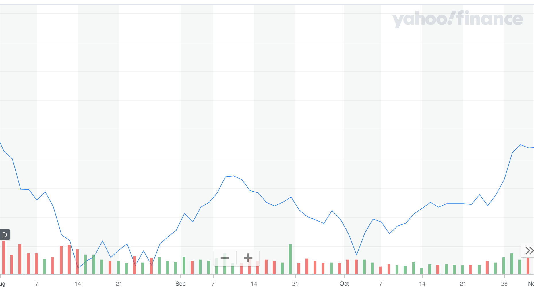
Pfizer - pharmaceutical company
Notes:
~same as FB, is fluctuating

Slide 29
Pfizer - pharmaceutical company
Notes:
~same as FB, is fluctuating

Slide 30
Moral of the story: if the trend of a stock is going up, down, or neither beforehand, it will likely continue to do that in the next period.
Notes:
Moral of the story: if the trend of a stock is going up, down, or both, it will likely continue to do that in the next period.
not always true, in fact , can be the opposite

Slide 31
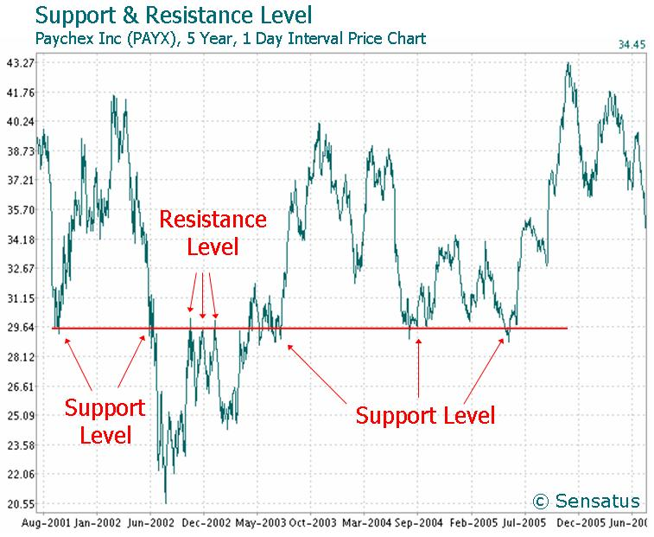
Technical Analysis!
Technical investors rely on the price of a stock over time to predict future prices.
See appendix more specifics
Notes:
Does not take into account other things, like how much the company makes or the value of its products/services (i.e. - fast food).

Slide 32
Fundamental Analysis

Slide 33
Company’s quantitative/qualitative status
less charts; more numbers and facts
numbers: How much money? What products sell more?
facts: What is business model? Who is the CEO?
Notes:
rather than predicting based on trends--may
two assessments -
Bath and beyond will be the case study

Slide 34
Bed Bath & Beyond
bed, bathing products, domestic products
bankruptcy soon? Caught in meme stock frenzy w/ GME, others (2021)
is it worthy of investing in?
Notes:
Which of the following is true about cash?
is an asset
can save companies from bankruptcy
is a liability
11) what is the benefit of cash flow?
tells you how financially stable a company is
tells you how profitable a company is
tells you how valuable a company is
Difference betwe
are the products important, especially now
what do you know about the ceo? iis he responsible? notable
what about competitors, how many times have you’ve gove there over bbby?

Slide 35
Bed Bath & Beyond: Qualitative
Who is CEO: Mark Tritton (recent-not exp)
Competitors: Walmart, Target, and JCPenney
Strategy:
Notes:
Which of the following is true about cash?
is an asset
can save companies from bankruptcy
is a liability
11) what is the benefit of cash flow?
tells you how financially stable a company is
tells you how profitable a company is
tells you how valuable a company is
Difference betwe
are the products important, especially now
what do you know about the ceo? iis he responsible? notable
what about competitors, how many times have you’ve gove there over bbby?

Slide 36
Bed Bath & Beyond: Quantitative
How much money is the company worth? (Balance sheet)
how much money is the company making? (Income Sheet)
How much money is in cash? (Cash Flow)
Notes:
REORDER POINT

Slide 37
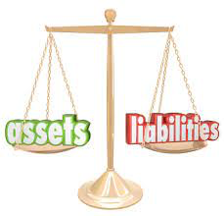
Balance Sheet
Notes:
balance because you have assets on one end and liabilities on the other.
liabilities - where you get your money from? (money influx?) loans
assets - how you spend that money (money outpour) - computers? office space?
WE FOCUS HERE ON ASSETS

Slide 38
ready to see the real thing?.......

Slide 39
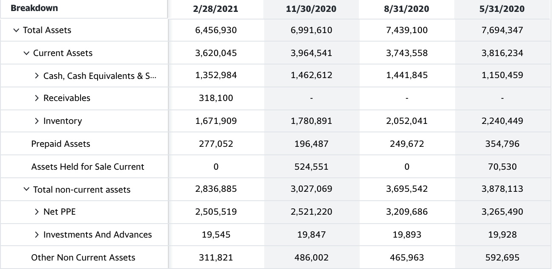
Balance Sheet
Balance Statement - can be used to determine the monetary value of a company.
Is it growing or increasing in financial value?
Notes:
Current - assets that are here and can be used / sold NOW; non-current - assets yet to come (investments,)
pay attention to TREND of assets over time (where is it?)
When companies like APPLE buy companies, this is the sheet used to ascertain value
Three types
now to balance statement - which can be used to determine monetary value of company
assets -> is monetary of company (desk, chairs, products, etc. - usually tangible things)
bbby was stagnate - not notable
assets - give you idea of how much a company owns (value)
can be used to determine how much a company costs when buying.
If assets are high - more (material) value
might want to invest?
value here is stag
missing liabilities
Cash ->
Receivables - money that is owed
Inventory -
Launch Quick quiz:
What is a fundamental analysis?
looking at price trends
looking at things like company revenue
neither
both (a/c)
How do you find net income?
sales from product minus ALL costs
Profit from other places minus All costs
What is it used for?
reinvestment into product
dividends
all of the abobe
What are assets?
cash value of company possession
money owed to another company
What are liabilities?
cash value of company possession
money owed to another company

Slide 40
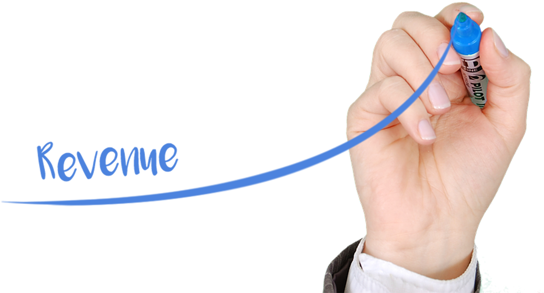
Income Statement
Notes:
cash flow - how much cash is generated or spent (net)
3 sources of cash flow (we’ll see them)/outflows

Slide 41
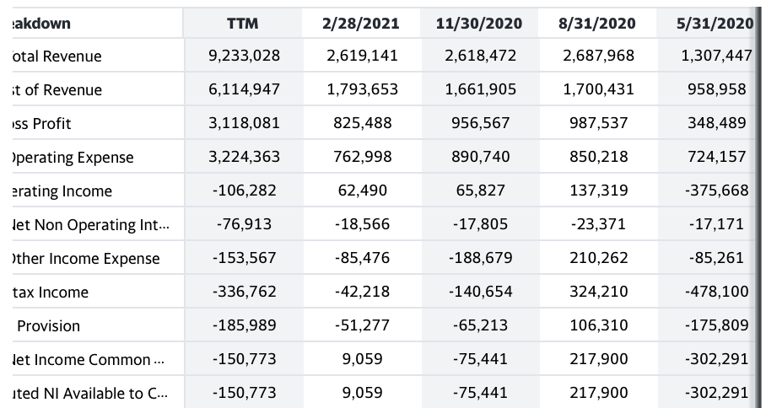
Income Sheet
Income Statement - Tells you how much profit/rev a company makes
Total Revenue - money made from sales of good (towels)
*Net Income - Revenue-cos
Notes:
Was BBY a good company?
Income Statement - Tells you how much profit/rev a company makes
revenue is found on top: quarterly rev is given - look at the trend
if you want net income (revenue minus cost) look down
takeaway looking at both give you a clue for how profitable a company is
food for thought - when is revenue more important than net income and vice cersa
Total Revenue - money made from sales of good (towels)
stagnates here
Cost - cost associated with towel productions
Time permitting:
Revenue - Cost of ALL expenses (ads) = NI
extra cash for reinvestment
fluctuate, close to negative

Slide 42
Cash Flow
Notes:
cash flow - how much cash is generated or spent (net)
3 sources of cash flow (we’ll see them)/outflows

Slide 43
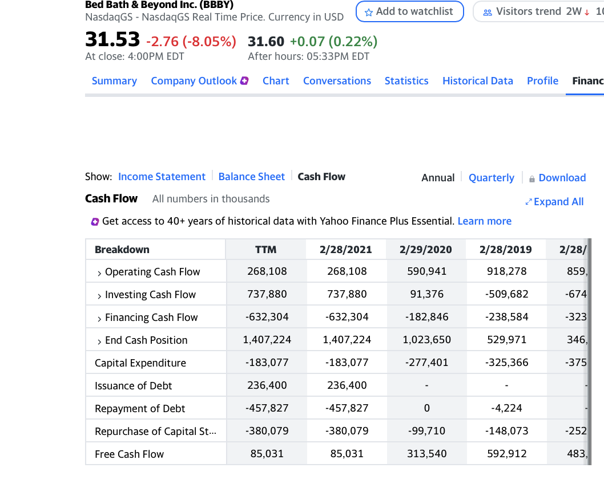
Cash Flow
Where might have increase come?
Cash Flow - how much hard cash company has
Notes:
Cash Flow - give an idea of how stable a company is (if likely to bankrupt or no)
End Cash Position => Operating + Investing + Financin
if there’s time, i’ll define them (
FRE cash flow = cash coming in - accounting for debt/capital/other hidden costs
operating - money from operations (selling products)
inventory - money from selling land/otther assets
financing - money from stocks/bond******chech
)
>>>>>for bbby cash flow of company increasing , a good thing
difference in income ane cash
if a company has profit, but its not in cash, its in danger;
it cant pay up right away
reflective of the fact taht in the past in was too fail
- - - - - - - - - - -
Before 2020, BBBY had very little growth, would not invest
but because of increases i showed you, perhaps can lead to profit (IF that’s your goal)

Slide 44
Quiz
What is a fundamental analysis
How do you find net income?
What is it used for
What are assets?
What is cash flow?
Why is cash important?
Notes:
What is a fundamental analysis?
looking at price trends
looking at things like company revenue
neither
both (a/c)
How do you find net income?
sales from product minus ALL costs
Profit from other places minus All costs
What are assets?
cash value of company possession
money owed to another company
What are liabilities? XXXXXXXXX
cash value of company possession
money owed to another company
Which of the following is true about cash?
is an asset
can save companies from bankruptcy
is a liability
ALL of ABOVE
11) what is the benefit of cash flow?
tells you how stable a company is
tells you how profitable a company is
tells you how valuable a company is
12) Income Statement?
tells you how financially stable a company is
tells you how profitable a company is
tells you how valuable a company is
13) Balance Sheet?
tells you how financially stable a company is
tells you how profitable a company is
tells you how valuable a company is
What is it used for? XXXX
reinvestment into product
dividends
all of the above
What are not PPE? XXXXXX
property
Office Space
inventory
debt
what are operating activities? XXXXX
activities conducted by the business from selling its good
activities from buying/selling property
money gained from shareholder
Investing activities?XXXXX
activities conducted by the business from selling its good
b) activities from buying/selling property
c) money gained from shareholder
financing activities?XXXXX
activities conducted by the business from selling its good
b) activities from buying/selling property
c) money gained from shareholder

Slide 45
fundamental analysis - recap
Deeper analysis
Looking at the “numbers/facts” (revenue, profit, cash flow, building equipment value, etc.), see 10K
Looking at the company subjectively: does it sell high-value products, how is the CEOs?
Notes:
many people look at the trends, but do they also do deep research
Where to find this info
MOst finance sites
also, the 10K or 10Q

Slide 46
Difference between Technical vs fundamental analysis (in 3 or less words)??

Slide 47
EXTRA MATERIAL FOR LEISURE (NOT IN LECTURE )

Slide 48
Investing Philosophy

Slide 49
Investing Philosophy?
How should I invest my money?
base on profit? value to society? ethical companies?
Overvalued/Undervalued Companies
ESG/Moral Companies
Notes:
SO YOU KNOW HOW TO ANALYZE COMPANIES, technical and fundamental, but still need some guiding principle on how to invest/ screen companies
these are the four categories we’ll look at, if you want to jot it down
pancakes/ vs oatmeal
BK, FANG, tesla
low prce - gamestop, bbby, so on
might want

Slide 50
Overvalued Companies
Well-known, WAY High market value
usually safe and less risky, but
slow growth
Tesla, Facebook, Netflix
earnings not very high comparatively
Tesla’s price per stock: $671
Tesla’s earnings per stock (EPS): 1
undervalued are opposite
Notes:
overvalued - companies that are
third point - its like paying tesla 671 dollars for them generate just one dollar worth of money
Undervalued is the opposite - (formerly) gamestop, amc, but also many smaller, less known companies
consider it when investing in companies -> both have their advantages; so pay attentino
what a

Slide 51
for Appendix
Pros and Cons
OverValued
low, less volatile
slow moving
Tend to be sold
UnderValued
more volatile, higher returns
tend to be bought more
Notes:
overvalued - a company whose price is much higher than its profit
Strategy: go for a mixed approach

Slide 52
ESG/Moral Companies companies
what about sustainable/ethical companies?
Environment - companies that are mindful of act against operations that hurt our environment
i.e. Bloom energy (uses hydrogen gas instead of carbon), any renewable;
Social - companies that have maintain positive social environment for its workers
i.e. (good pay, diversity) tech comp
Governance - companies where board of directors has positive interests, ceo has fair pay
i.e.
Notes:
important to know as your fa might apply this
if you’re concerned look at ESG stocks -
acronym
ESG stocks are known for being sustainable and good corporate practices
to go deeper, her’s what each things means:
example f4 social - axon, microsoft, tech in general
theses are just companies that can used as an example
4govt - are the leaders looking out for themselves or company
There mtfs that screen so no need to do the reseach
what are companies you consider to be ESG and undervalued/overvalued; we can talk about it??

Slide 53
Moral Investing
i.e. Stocks that align with values of particular religion - SIMILAR TO ESG
Are many kinds (christian, islamic, Jewish etc.)
A christian portfolio, i.e., might avoid companies w/ antithetical value s(“tobacco, gambling…”)
*Returns from moral/ESG aren’t much different from other
Notes:
https://www.investopedia.com/articles/stocks/12/investing-and-faith.asp#does-faith-based-investing-work’
There mtfs that screen so no need to do the reseach
idea is to show you how varied companies can be, and how you can choose the stock that you desire

Slide 54
Social Justice/Responsibility Investing
> Three ways to impact companies
Divest
Invest in better companies
Protest (use shares to vote)

Slide 55
What else can you do with your shares: vote
You can use your shares to vote:
Influence company decisions/CEO
Change up the board of directors
Notes:
Each share gives you one vote
If someone owns more than 50% of company-- they can basically control the firm (i.e FB)

Slide 56
Case: Rio Tinto
> works in location in Spain
> 2nd largest manufacturer of metals: gold, uranium, steels, etc.
-> mining company
-> controversies: human labor & carbon emissions
-> divest? Or what? Invest in ESG? Voting right

Slide 57
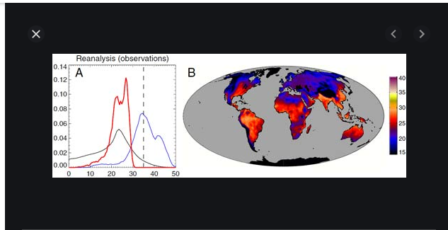
Why divest?
Some companies emit too much carbon
Could be approaching a danger zone in terms of global warming
Notes:
35 degrees is lethal ; this measures wet bulb temperatures (takes into account humidity, not just raw temperature) We see that parts of southern hemisphere are at risk…..this is one argument to make for divestment from fossil fuels
Enphase, renewable energy group, solar edge -> avoid investing TOO much into companies (rio tinto, Exxon,

Slide 58
Takeaway
Materials
> Three ways to impact companies
Divest
Invest in better companies (i.e ESG)
Protest (use shares to vote)

Slide 59
A quiz!
Notes:
What are undervalued companies?
-companies with high value but low price
-companies with low value but high price
-companies with low value and low price
What are overvalued companies?
-companies with high value but low price
-companies with low value but high price
What rights do you have as shareholder?
We have apple, a large company whose products are popular? It is, likely,
overvalued
undervalued
We have Oatly, a vegan milk producing company, that recently came to the market, it is most likely
overvalued
undervalued
What does ESG stand for?
a) Environmental, Smart, Governance
b) Environmental, Social, Governance
c) Environmental, Social, Government
What is divestment?
a) invest in
b) withdraw money
What options do have to make changes to company?
a) invest in another company
b) invest and vote in the board
c) divest from it
d) a, b, and c
what is governance?
refers to the government and law
refers to the board of directors
refers to the pay of employees
none of the above
What is one advantage of overvalued companies?
very volatile
high returns
usually safe, stable
What is one advantage of undervalued companies?
very volatile
high returns
usually safe, stable
What is one advantage of overvalued companies?
very volatile
high returns
usually safe, stable

Slide 60
Takeaway
-> What is a stock? How do I invest?
-> Ways to research
Technical Investing
Fundamental Investing
-> How to choose?
- undervalued companies
- overvalued companies
- ESG companies

Slide 61
APPENDIX

Slide 62
Appendix

Slide 63
Investing Indicators used by Technical Investors
Volume
Momentum indicators
Oscillators
Moving Averages

Slide 64
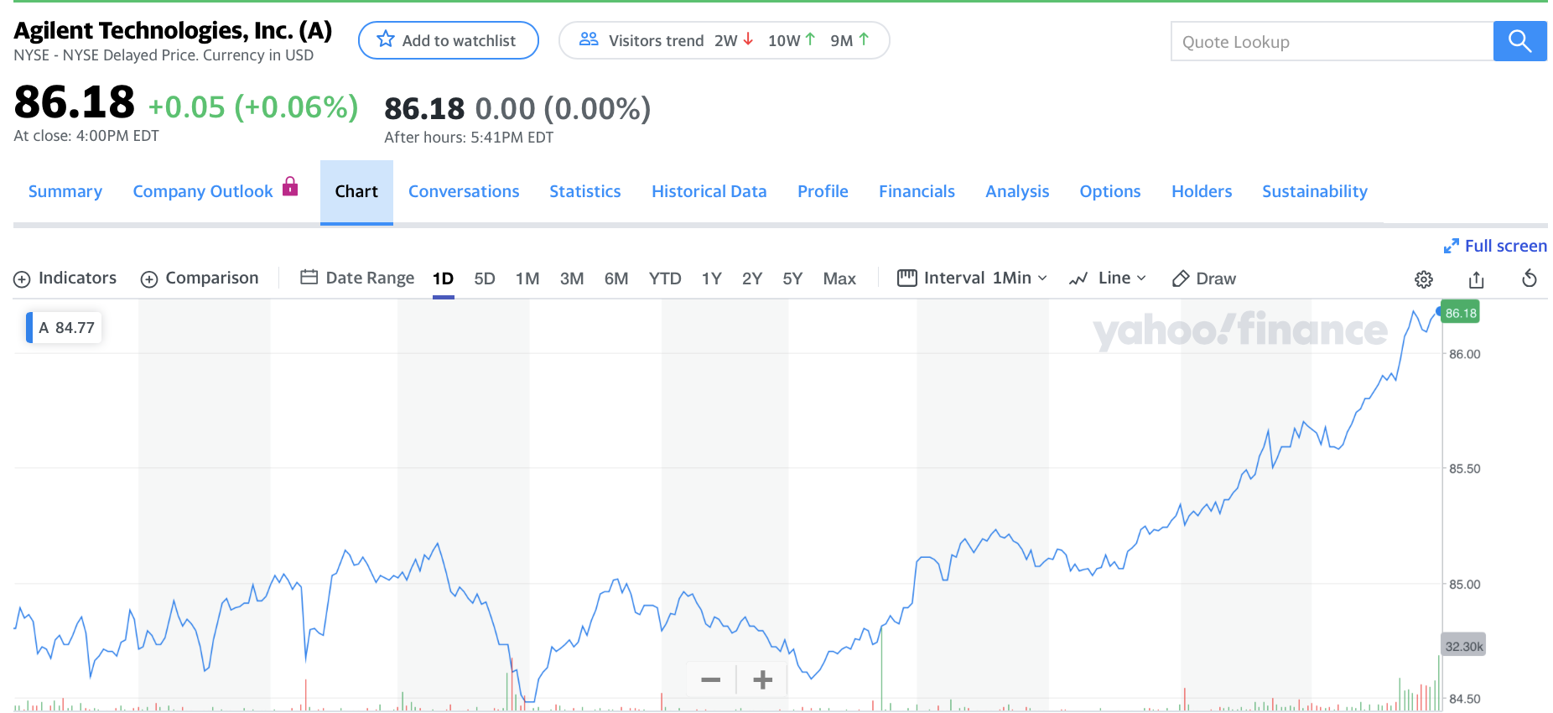
Volume
Number of buys and sells made in a period
Notes:
significance: tells you how liquid a stock is. The less volume, the less likely tithe stocks will trade and thus the less likely you will be able to obtain your stocks back if you invest.ac
The higher the volume with the price move, the more “significant” it is

Slide 65
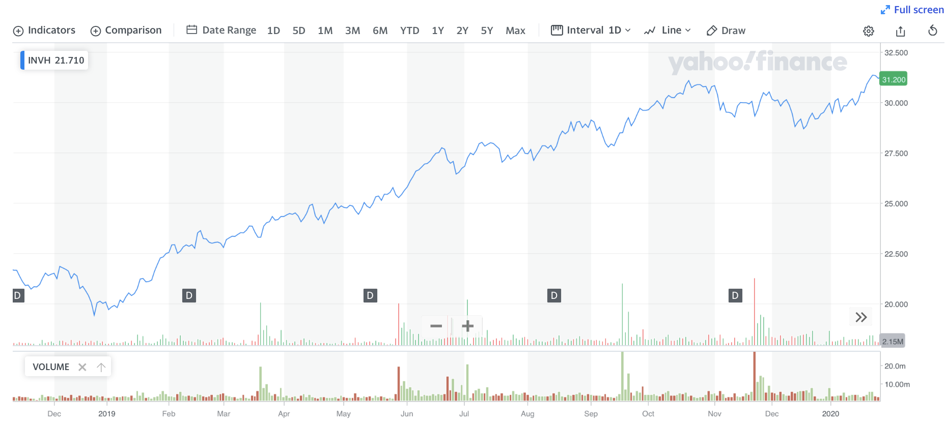
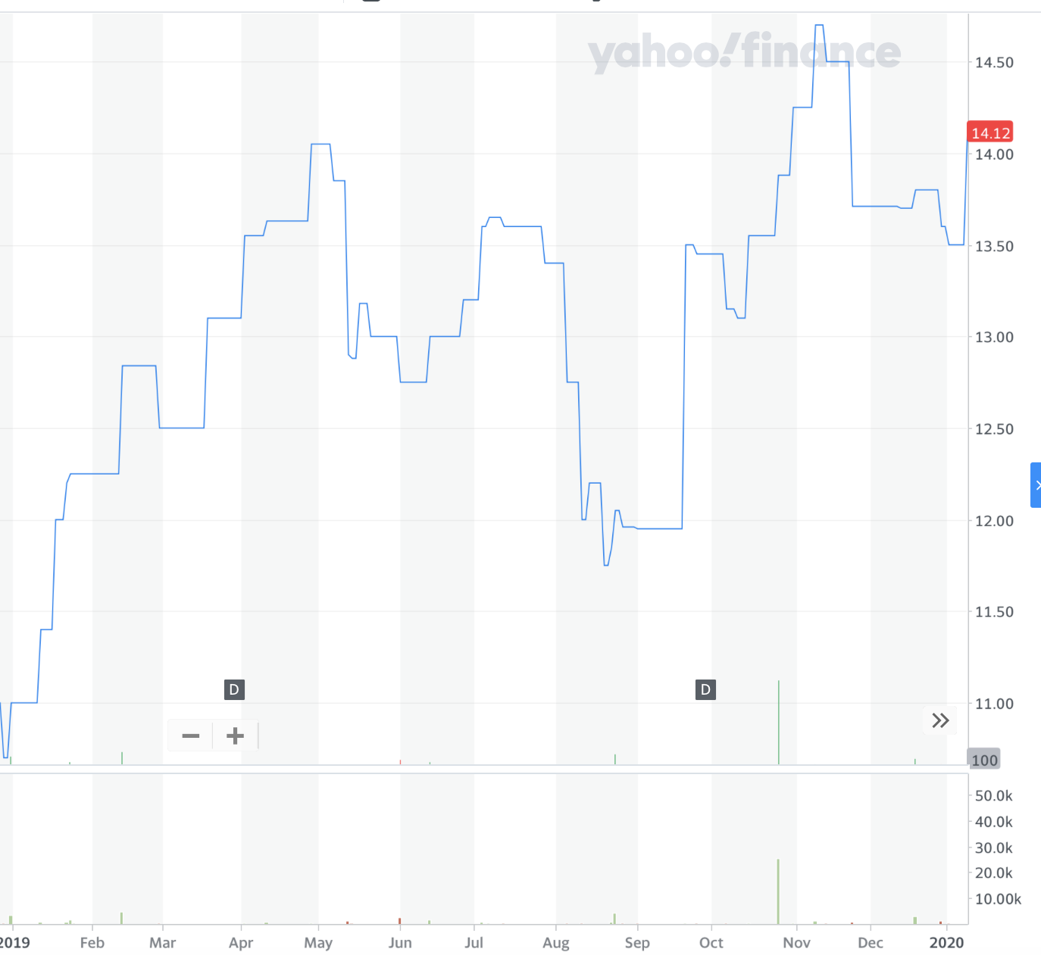
Invitation homes
Mitsubishi Electric Corporation (MIELF)
Notes:
10:05

Slide 66
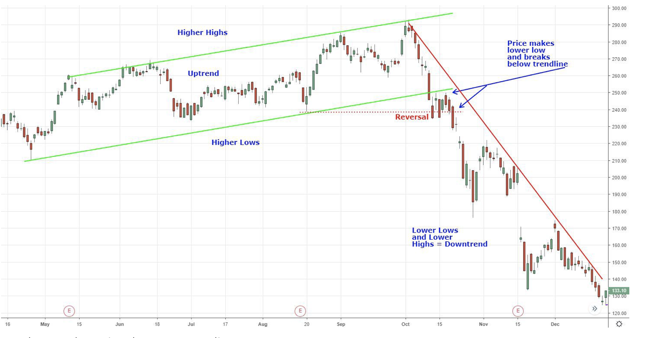
Reversals
The transition from an uptrend to a downtrend, as seen below

Slide 67
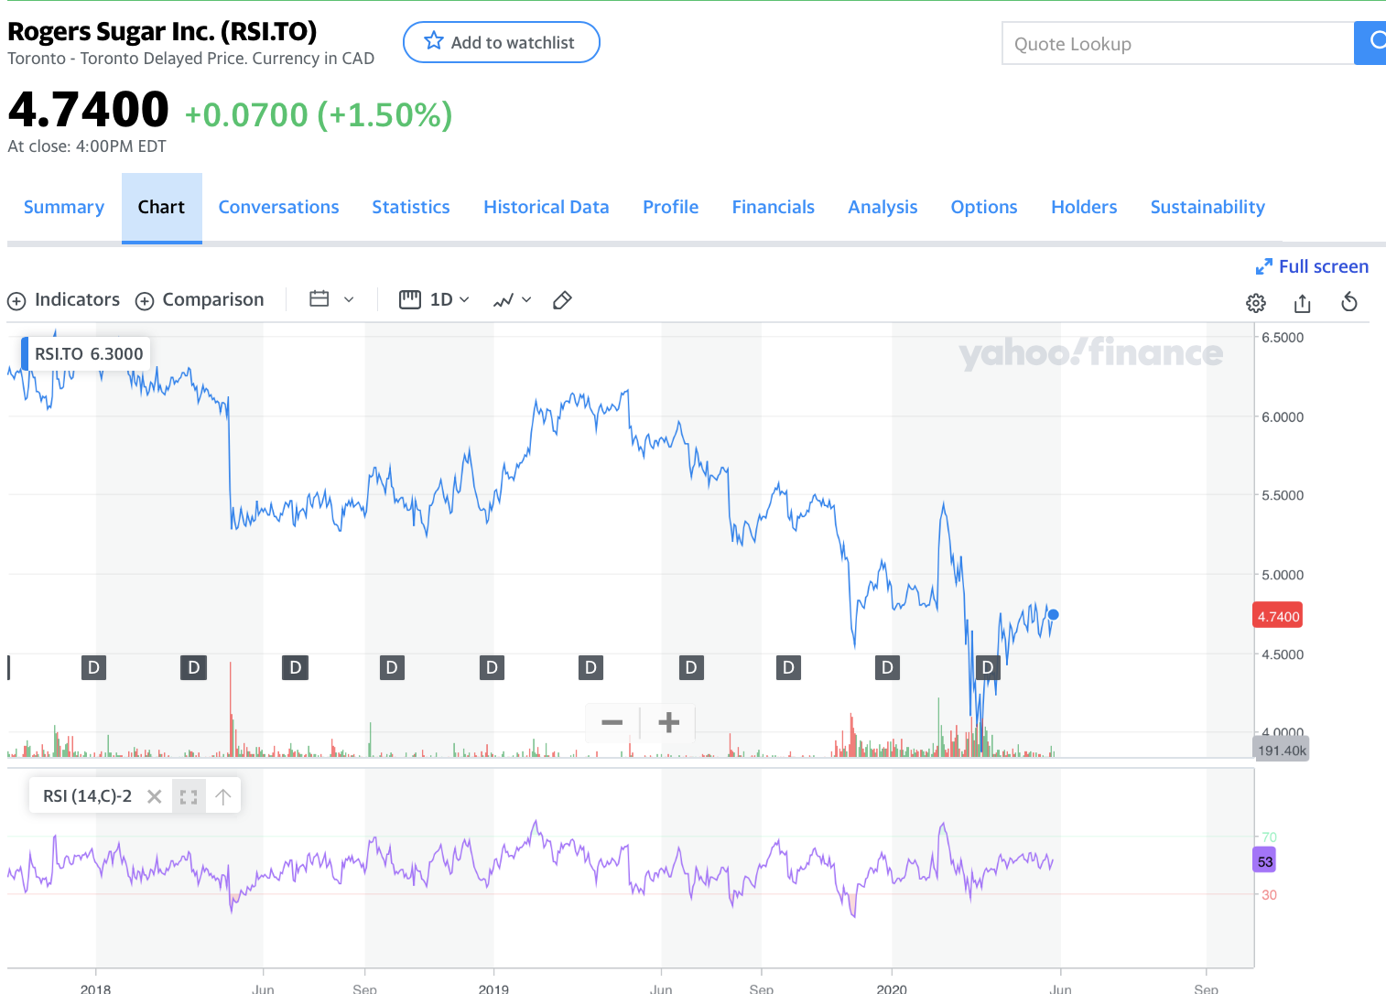
Oscillators
An indicator used to determine whether a stock is about to enter an upward trend or downward trend
Relative Strength Index - popular oscillator. Considered to be ready to enter a downward trend if the index is above 70, and upwards if index is below 30.
Notes:
RSI is depicted at the bottom of the graph; When the purple line intersects the green line, it indicates that the stock will undergo a downtrend. When intersecting the red line the opposite is true.

Slide 68
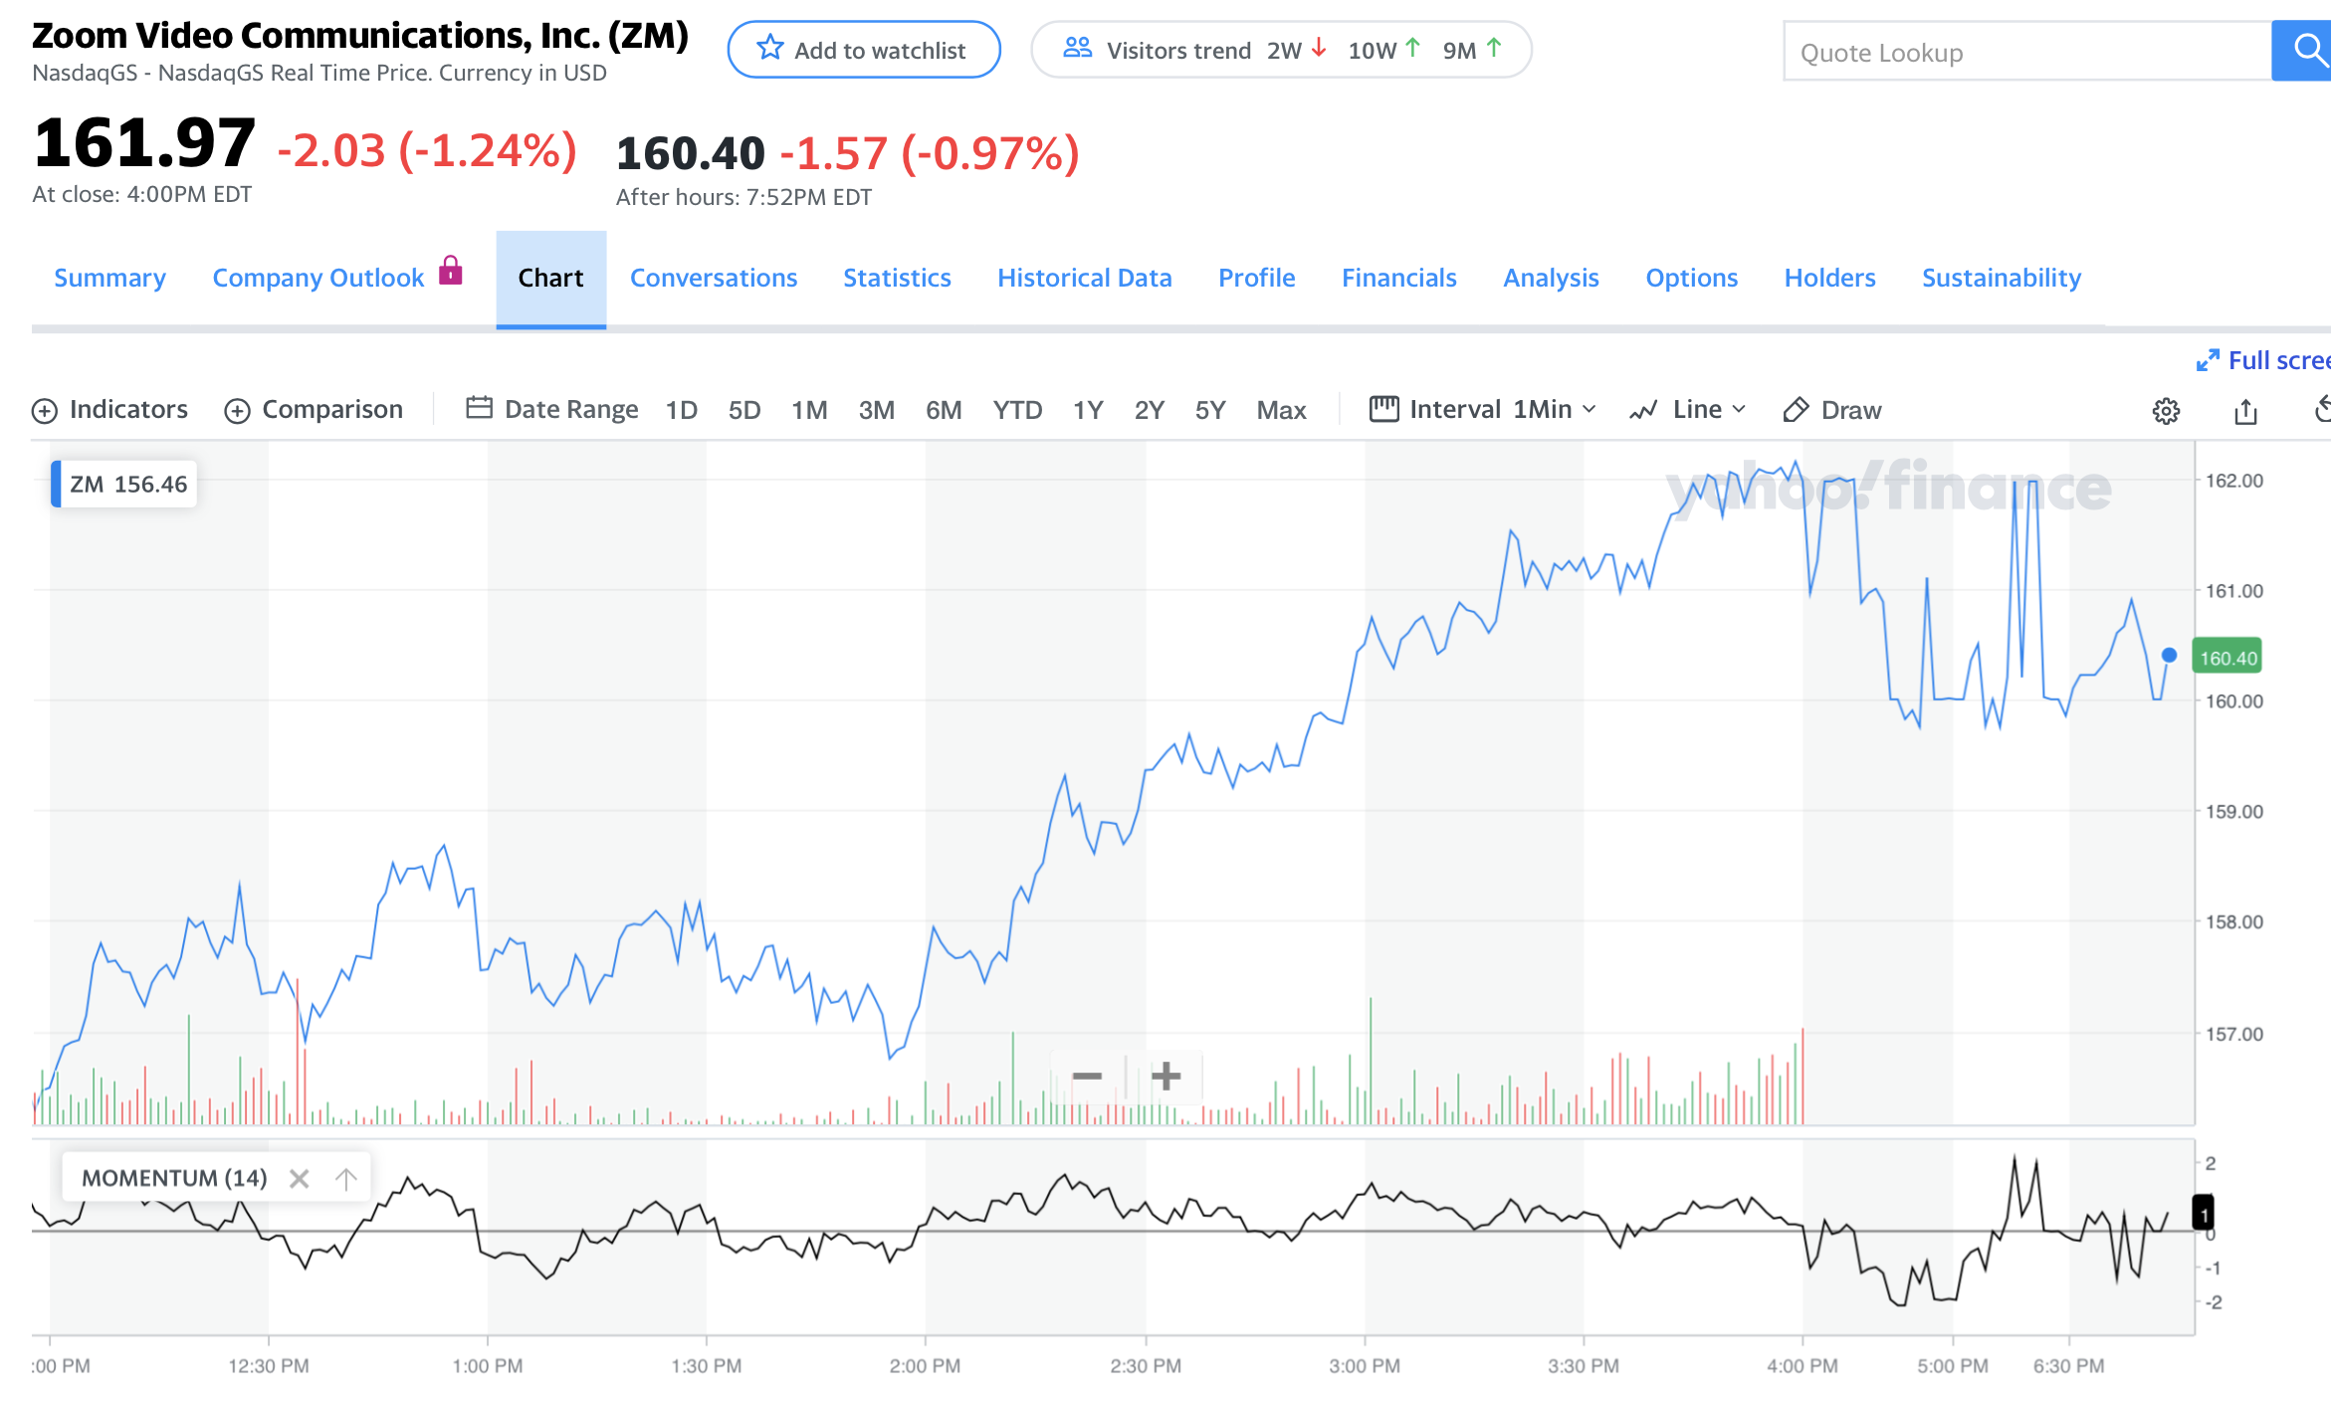
Momentum
Rate of change for a particular asset:* P_{now} - P_{last}
Notes:
; Tells you if a stock is increasing in price over time, or decreasing
1min

Slide 69
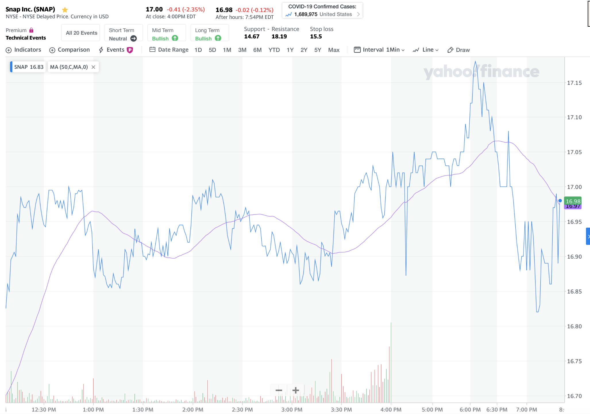
Moving Averages
average price over a particular period of time (usually 14 days or 50 days)
Notes:
Tells you what the price is after taking out fluctuations that are due to presumably minor changes, maybe accidents in trading or one time events like a one-day financial market crash

Slide 70
Market Orders
Market order -> buy a stock at the current price
i.e JP Morgan is at (5$)
Market price is always changing
Stop Order -> Buy a stock at a specific range (5$ or higher)
i.e JP Morgan is at $5. as you order, it goes up $6.
Eliminates risk of swift changes

Slide 71
How to stocks pick?!?!?!
lazy way: invest in an index fund -
i.e. S&P 500
index -> tracks the up and down movement
mutual fund;
focus on one or two industries you know best
How to incorporate a Technical Analysis?
Notes:
index fund - tracks movement of stock; if appl and tesla are moving up, fund goes also up

Slide 72
Should you invest in ESG?
Is it worth it?
Notes:
add slide about RS

Slide 73
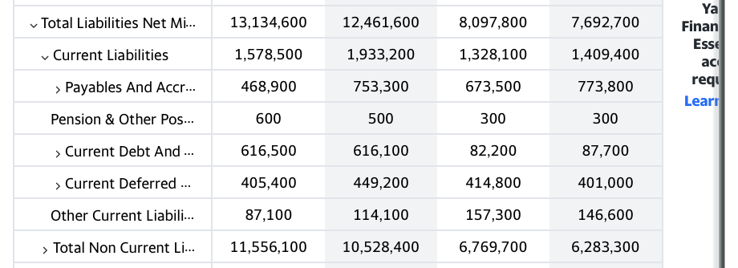
appendix
Notes:
liabilities - what is owed

Slide 74
UNUSED, OLD MATERIAL
(FEEL FREE TO
IGNORE)

Slide 75
Which company is the better investment (in terms of profit)?
Notes:
I will show you two stocks; using the shown, choose whichever stock is the best investment to you

Slide 76
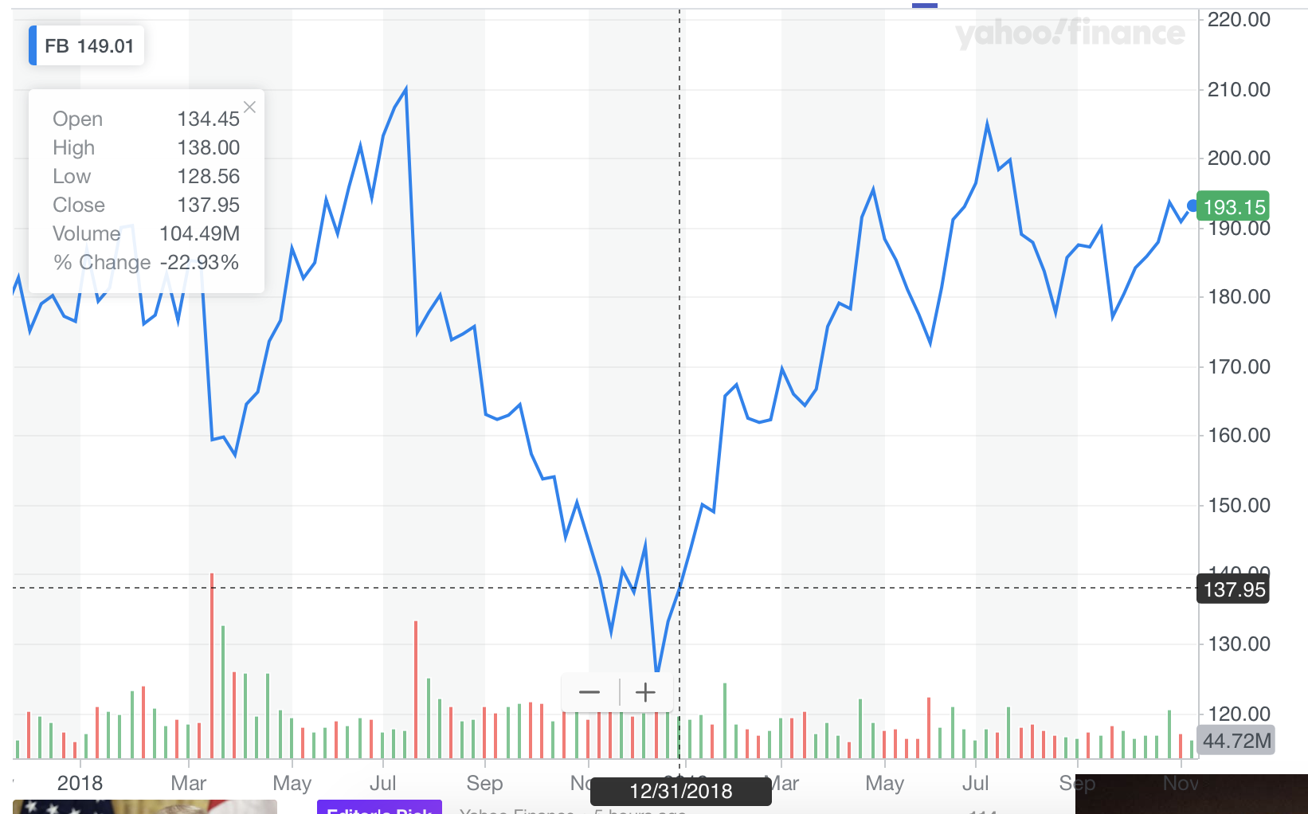
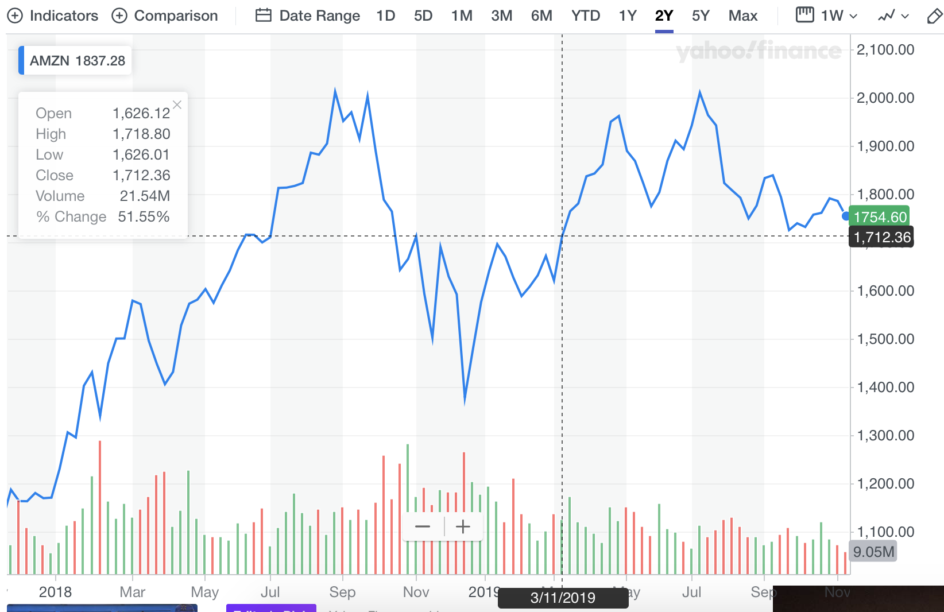
Facebook
Jan 2018: $179
Jan 2019: $143
Nov 2019:?????????????????????
Amazon
Jan 2018: $1229
Jan 2019: $1602
Nov 2019:?????????????????????
Notes:
Which is the better investment? Facebook or Amazon

Slide 77
Facebook rises from 143 to 193
Amazon rises
from $1602 to $1754!
Notes:
Amazon is the better investment; if you look at the previous slides, Amazon had a stronger upward momentum
However, Facebook is the better stock (has the better Percentage return);
Which investment will yield the most profit?
Facebook:
Invest in stocks with lower prices but high growth.
Amazon.
- Rising growth trend

Slide 78
1 Stock of Fb = $50 profit
11 Stocks of Fb = ???
Amazon profit = 150
Notes:
The math that shows that FB has the better percentage return

Slide 79
143 * 11 ~ 1602
193 * 11 ~ 2103
$501 (fb) > $152 (amazon)
FB has a better return
Notes:
continued

Slide 80
Percentage Increase > Increase in Price
Fb: ~25% increase price
Amazon ~8% increase in price
Lesson: If you’re looking to make a profit, don’t pay too much attention to how much a stock goes up, pay more attention to its percentage increase, that usually means cheaper stocks

Slide 81
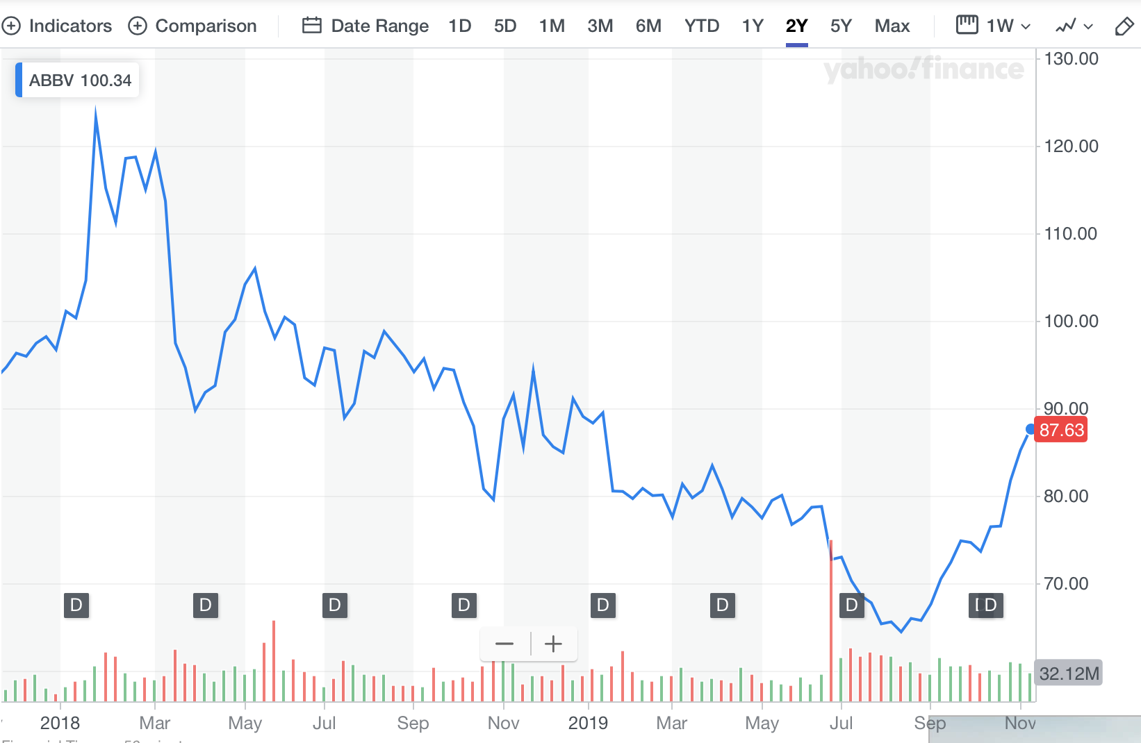
Pfizer:
Industry -> Health
2018: $36.80
2019: $42.88
2019 Nov: ??????????????
Abbvie:
Industry -> Health
2018: $96
2019: $92.19
2019 Nov: ?????????????????
Notes:
Which one to invest in?

Slide 82
Pfizer vs Abbvie
Pfizer went from $42.88 to 36.55 (15% decrease)
Abbvie goes from $92.19
To 87.63 (5% decrease)
Notes:
Both fall here, but Abbvie is the better investment.
Does technical investing strategies (looking at the trend) always successful?

Slide 83
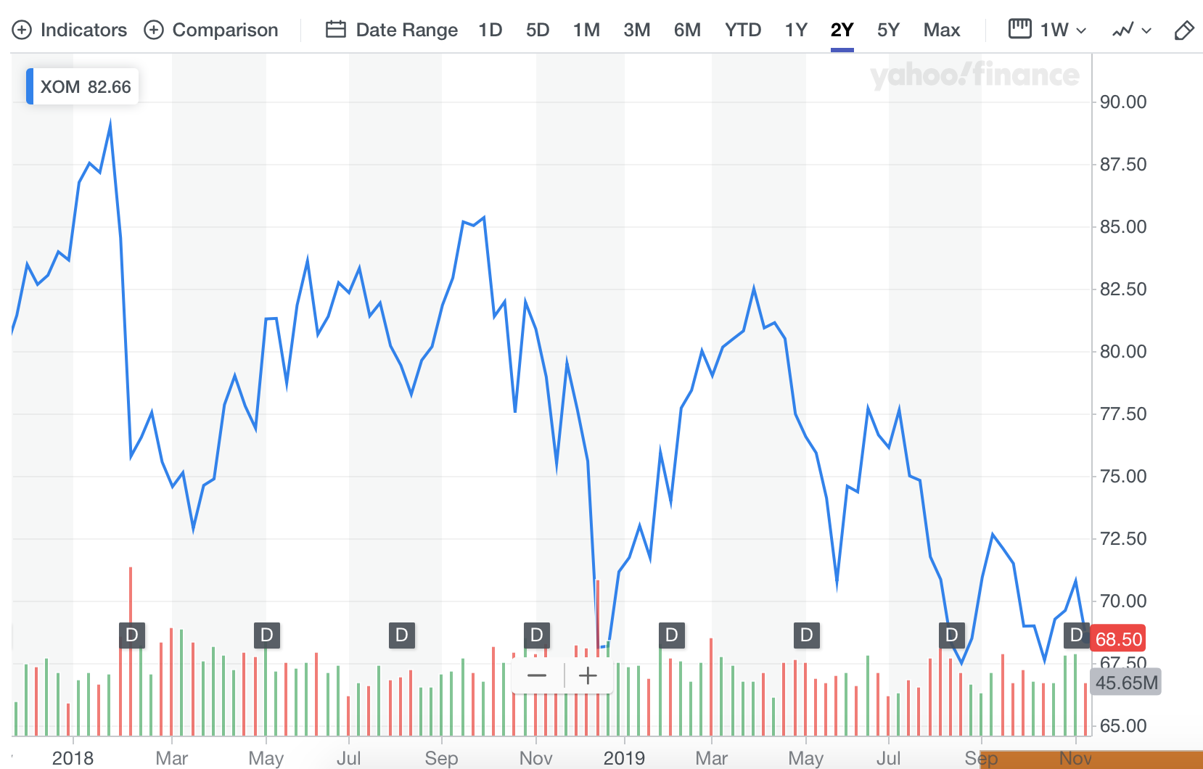
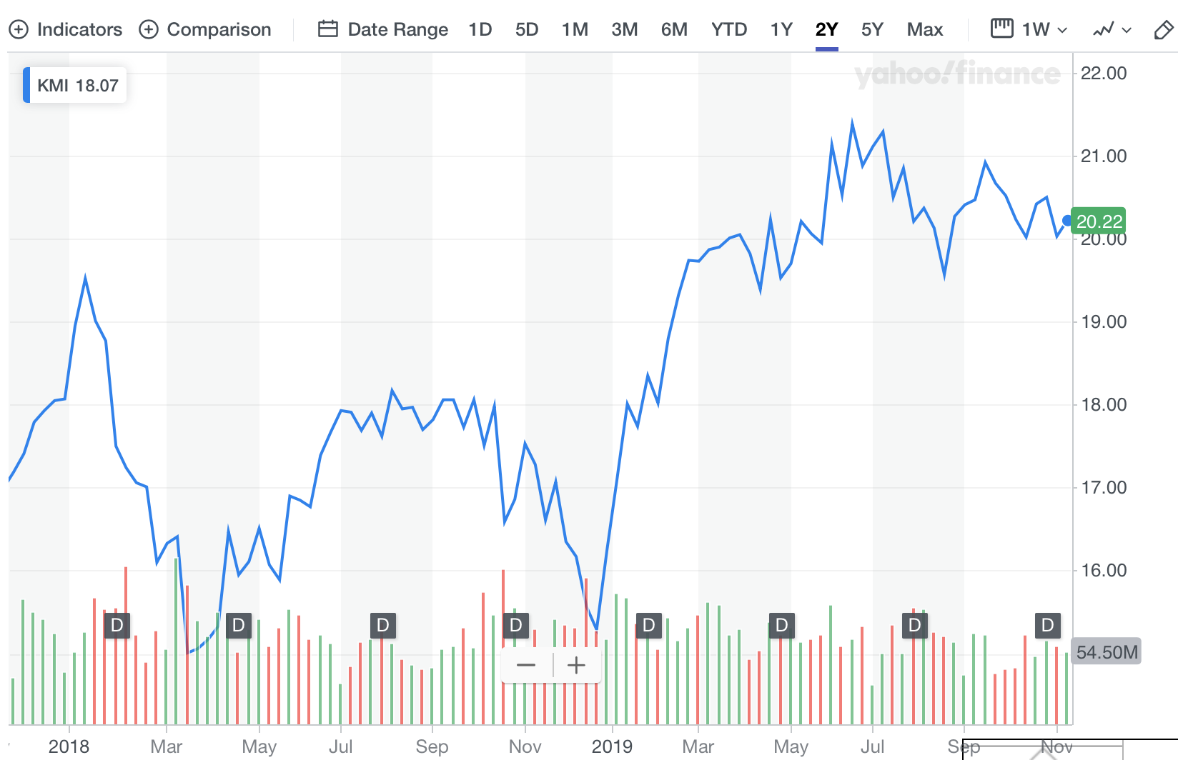
Exxon Mobil vs
Kinder Morgan
Exxon Mobil
Oil
2018: 86.75
2019: 71.72
Kinder Morgan
Oil
2018: 18.95
2019: 17.11
Notes:
Which stock is the better investment?

Slide 84
Exxon Mobil vs Kinder Morgan
Prices decreases from $71.72 to $68.50.
Prices increases from $17.11 to $20.22.
Notes:
Kinder Morgan is the better investment,
Follow-up: Do the graphs look similar and why?
Answer is down here VVvVVVV
Yes; Both are in the same industry; and therefore, will have similar stock trends. In fact, the returns of the company aren’t that different from each other.

Slide 85
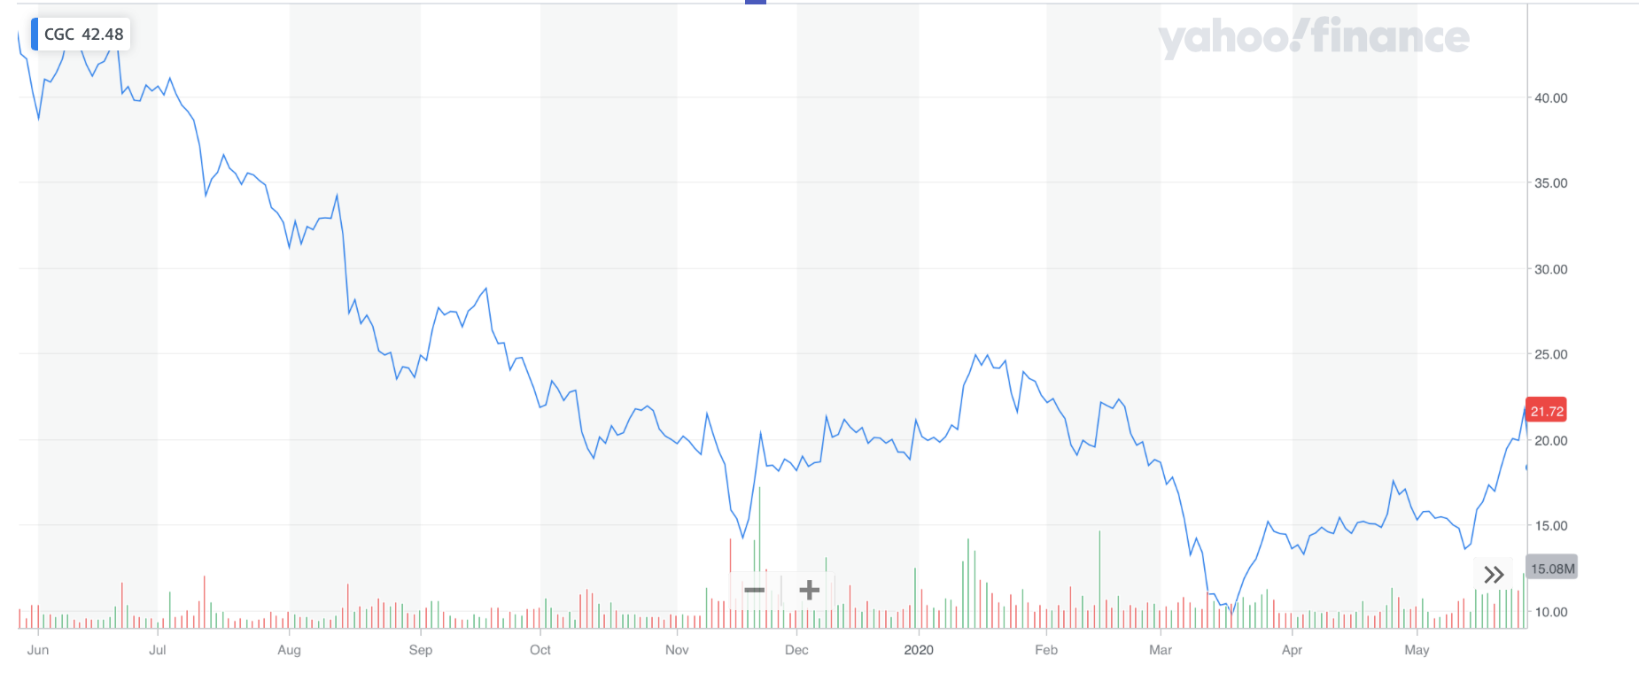
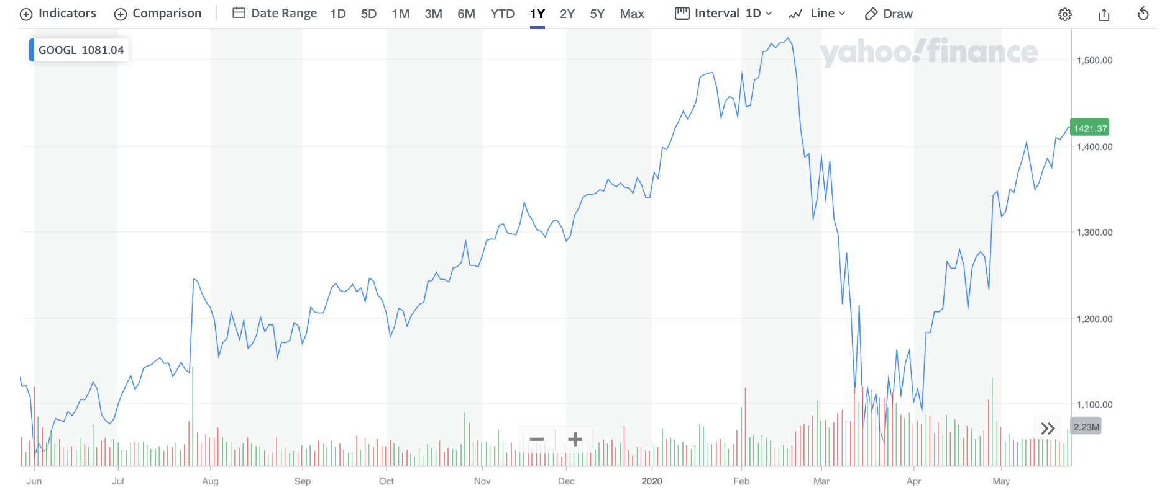
Canopy Growth
Corporation vs
Google
Canopy Growth Corporation
Industry: IT
Market Cap: 9.302 Billion
Google
Industry: IT
Market Cap: 727 Billion
Notes:
Google or Canopy?

Slide 86
Canopy Growth
Corporation vs
Google
Canopy Growth Corporation
Industry: IT
Market Cap: 9.302 Billion
Google
Industry: IT
Market Cap: 727 Billion
Notes:
Google is the better choice, as it has a positive uptrend in price.

Slide 87
RANDOM JUNK

Slide 88
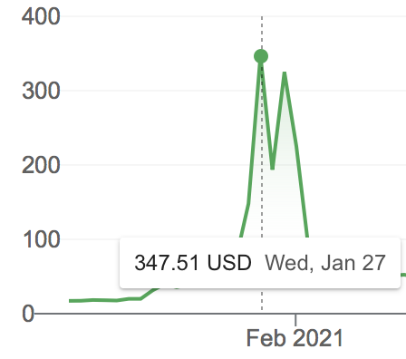
Consumer Discretionary
Gamestop
a bunch of people bid up price of gamestop;
slowly selling; possible bankruptcy
prices reaches around $400
hurts hedge fund & Robinhood
Share ownerships reduced to stop the spike

Slide 89
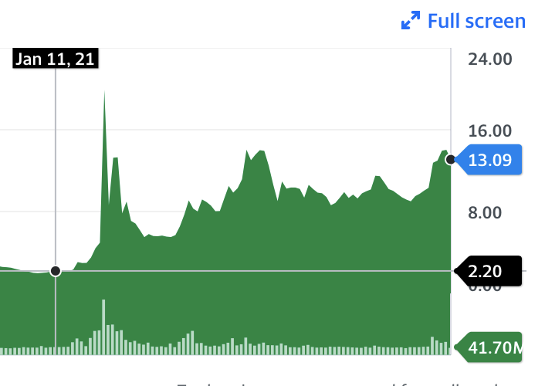
Others
other companies (AMC i.e) had similar experiences
Notes:
https://www.cnet.com/personal-finance/investing/robinhood-backlash-what-you-should-know-about-the-gamestop-stock-controversy/
BB, NOK

Slide 90
Takeaway
-> it was so short…(lasted ~2 days)
really easy to have lost money then have gained:
-> market is not robotic
ppl invest in what they care for
-> observ:
the market is truly powerful (who knows how many people traded?)

Slide 91
How does it all work: from the company side
an entity owned by people(s) that produces a good or service
nonprofit vs profit
Nonprofit take money from investors
provide a public good
money not paid back to investors
profit
private good
money paid back to investors
Notes:
take investments and put it to use its in company; also provides a public(widely accessible) good
profit: might give back to shareholders
nonprofit vs profit (i.e MIT)
Nonprofit take money from investors
provide a public good
money not paid back to investors
profit (i.e. bank)
private good
money paid back to investors

Slide 92
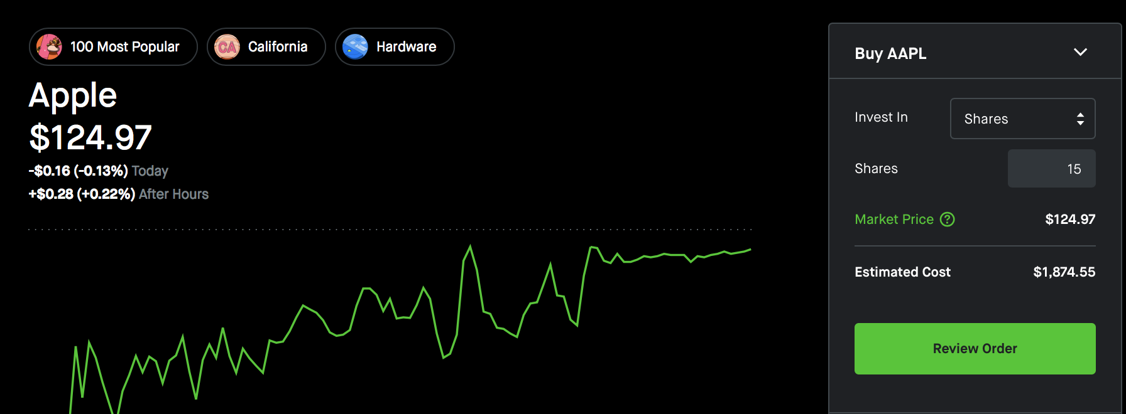
How to actually buy/sell/read stocks
i.e robinhood, etrade, ….
Notes:
depending on what where you go, this is what you might see
how much is 10 shares of apple? 1249.7
process is somewhat similar in person and for mutual funds

Slide 93
Calculate profit
You can invest $1000 into Fund X for $20
How many shares?
1000/20 = 50
for each share the payout quarterly (4x a year) is - $4
yearly payout - 4 X 4 * 50 =
Return in 5 years?
Notes:
16*50 = 800
< 4000
*not guaranteed; money manager can underprorm or the economy can fail
*even more if capital gains

Slide 94
Discussion
What is a stock?
a piece of a company
a small sum of money
a good or service
an inventory
How can a >21 yr old (with permission) get started in investing?
What is a technical analysis?
Notes:
use kahoot questions (should take about 1-3min) (3-6min)

Slide 95
AMC - Qualitative
competes with watching indoors (netflix, disney)
many financial issues in past
Business severely impacted by pandemic
An upside - seemingly better now?

